Slide 1


Hosting Options for the SIOFA VMS
Johnny Louys
Compliance Officer
(p): +262 (0) 693 44 35 35
(e): johnny.louys@siofa.org

Slide 2

Presentation Outlines
Background
Hosting Options
Practices by other RFMO/Bs
Resource Implications
Additional Remarks
Conclusions

Slide 3
Background
Adoption of CMM 16 (2023) – Vessel Monitoring System by MoP10
Establishment of VMS WG by MoP10
Adoption of the SIOFA VMS SSPs by MoP11
Agreement to continue intersessional works by MoP11

Slide 4
Hosting Options
Software as a Product
  Client Purchases ownership of software/service
  Deployed and managed on-site
  Deployment also requires the installation of necessary infrastructure (servers, networks, data storage modular services etc)
  One-off payment structure

Slide 5
Hosting Options
Software as a Service
  Client subscribes to access software/service
  No deployment required (Cloud-based)
  Minimum infrastructure required
  Payment structure is usually based on the duration of access to service (monthly or annual payments)

Slide 6
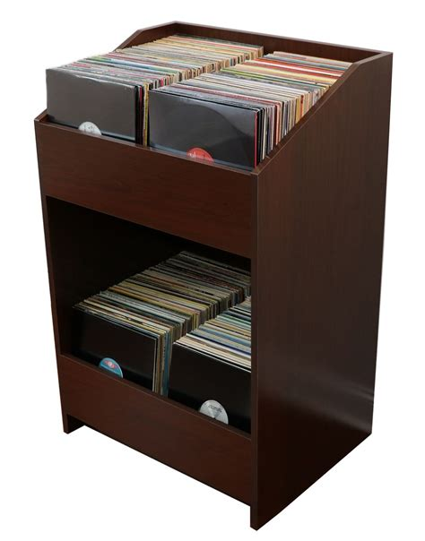
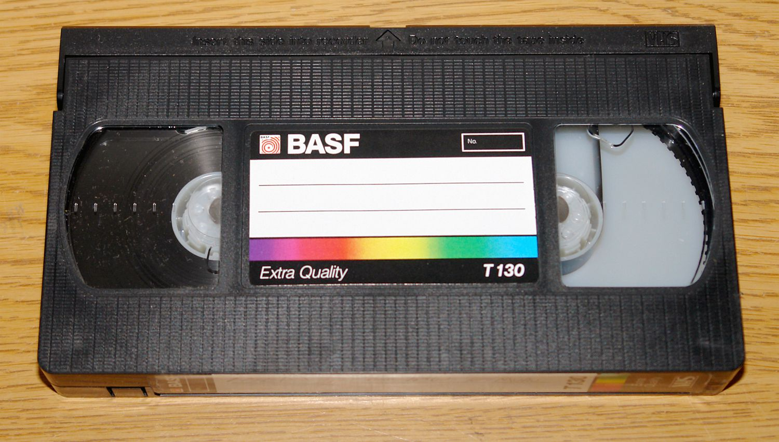
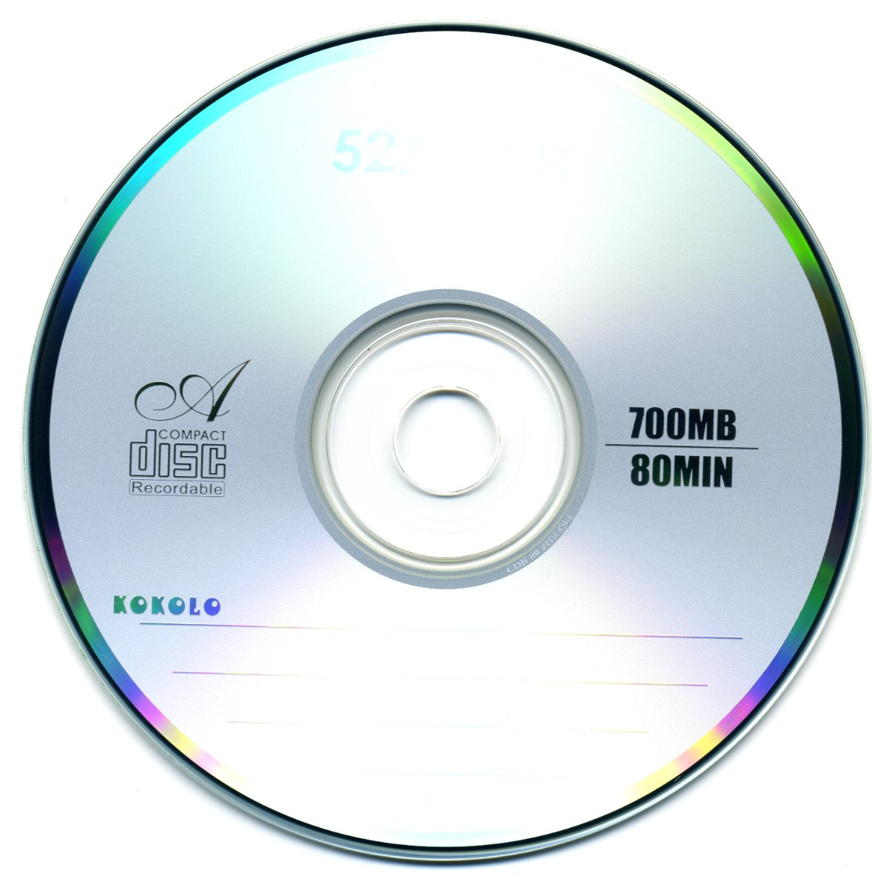

Hosting Options
Software as a Product

Slide 7




Hosting Options
Software as a Service

Slide 8
Hosting Options
Comparison of Common Attributes
ATTRIBUTES | SaaP | SaaS
DEPLOYMENT LOCATION | On-Site | Cloud-Based
CONTROL | Possible, but it comes at a cost /a may required additional infrastructure | Limited based on hosting technology, (although improvements are noted)
SECURITY | High, but contingent on available infrastructure further impacting cost | Service dependent, but in most cases offering security measures on par with SaaP deployment
SCALABILITY | Limited flexibility | Flexible
COST STRUCTURE & EXPENSES | One-off, new services may require reinvestment, high upfront cost. | Based on duration of service (monthly or annually), cost commensurate with types &level of services required

Slide 9
Hosting Options
Comparison of Common Attributes
ATTRIBUTES | SaaP | SaaS
UPGRADES & MAINTENANCE | Generally, it requires additional reinvestment and substantial man-hours for major upgrades. Maintenance may be costly | Upgrades will only impact subscription costs, and deployment of new services is immediately (over the air) Included as part of the Service Agreement
DATALOSS & REDUNDANCIES | Requires suitable infrastructure, specialized hardware and technical expertise to meet minimum requirements to implement dataloss prevention measures | DLP may be included in the service level agreement. Cloud computing is inherently designed with redundancy in mind

Slide 10
Comparison costs associated with Deployment Models

Slide 11
Practices by other RFMO/Bs
Organization | Deployment Model | Other Remarks
CCAMLR | SaaP | VMS position reports submitted directly to the Secretariat VMS data managed by compliance staff, with in-house IT support SaaP consumes significant IT resources
NPFC | SaaS | effective way to manage and analyze VMS data securely with minimum human capacity Data analysis and system support responsibilities shared among Secretariat staff (no dedicated IT Support)

Slide 12
Practices by other RFMO/Bs
Organization | Deployment Model | Other Remarks
SPRFMO | SaaS | Data analysis and system support responsibilities shared among Secretariat staff (no dedicated IT Support) VMS issues biggest day-to-day tasks of the Compliance Manager, with around 800 vessels reporting to the commission VMS Technical support provided by service provider

Slide 13
Resource Implications – Considerations
Resource | SaaP | SaaS
System Acquisition | Purchase of software license Purchase and configuration of servers (~4) Shipping, Installation & Deployment | No deployment (or additional onsite support necessary) Access to service immediately after commencement of service agreement
Infrastructure | - Requires more infrastructure (server room with environmental control, network with access control, physical access control procedures), UPS ect | - Requires minimum infrastructure to operate

Slide 14
Resource Implications – Considerations
Resource | SaaP | SaaS
Staffing | May need additional IT support staffs from point of deployment Additional support for maintenance of infrastructure (a/c, UPS, network) | Minimum/ no dedicated IT support required

Slide 15
Resource Implications
Indicative Expenditures (Cap-Ex)

Slide 16
Resource Implications
Indicative Expenditures (Op-Ex, SaaP)
Expense Categories
YR
-
1
YR
-
2
YR
-
3
YR
-
4
YR
-
5
Cumulative
1. System Maintenance
€ 41,085.03
€ 42,440.84
€ 43,841.38
€ 45,288.15
€ 96,884.53
€ 269,539.93
1.1 Subscription Fees (Annual)
€ 0.00
€
0.00
€ 0.00
€ 0.00
€ 0.00
€ 0.00
1.2 Hardware Maintenance /
€ 0.00
€ 0.00
€ 0.00
€ 0.00
€ 50,101.87
€ 50,101.87
Replacement
1.3 Technical Support Contract
€ 41,085.03
€ 42,440.84
€ 43,841.38
€ 45,288.15
€ 46,782.66
€ 219,438.06
(Annual)
2.
Staffing
€ 42,496.26
€ 43,898.64
€ 45,347.29
€ 46,843.75
€ 48,389.60
€ 226,975.55
2.1. IT Officer
€ 36,496.26
€ 37,700.64
€ 38,944.76
€ 40,229.94
€ 41,557.52
€ 194,929.12
2.2. Staff Capacity Building
€ 6,000.00
€ 6,198.00
€ 6,402.53
€ 6,613.82
€
6,832.07
€ 32,046.43
3. Infrastructure
€ 8,400.00
€ 8,677.20
€ 8,963.55
€ 9,259.34
€ 44,863.95
€ 80,164.04
3.1. Internet Subscription
€ 1,000.00
€ 1,033.00
€ 1,067.09
€ 1,102.30
€ 1,138.68
€ 5,341.07
3.2. Networking
€ 1,000.00
€ 1,033.00
€
1,067.09
€ 1,102.30
€ 9,678.77
€ 13,881.16
3.3. Accessories for Servers
€ 1,9
62.70
€
2,027.47
€
2,094.38
€
2,163.49
€ 2,
234.8
9
€ 10,
482.92
3.4. Room Temp/ Humidity
€ 1,500.00
€ 1,549.50
€ 1,600.63
€ 1,653.45
€ 5,693.39
€ 11,996.98
Control
3.5.
Server Room and
Secretariat Security
€ 2,000.00
€ 2,066.00
€ 2,134.18
€ 2,204.61
€ 11,386.79
€ 19,791.57
Improvements
3.6. UPS
€ 1,000.00
€ 1,033.00
€ 1,067.09
€ 1,102.30
€ 14,802.83
€ 19,005.22
3.7 Workstation
s
€ 0.00
€ 4,132.00
€ 0.00
€
4,409.21
€ 0.00
€ 8,541.21
4. Contingencies (@ 1.1%)
€ 1,012.48
€ 1,045.90
€ 1,080.41
€ 1,116.06
€ 2,092.30
€ 6,347.16
5.
Annual Inflation Rate
3.3%
3.3%
3.3%
3.3%
3.3%
-
Annual Indicative OpEx
€ 93,056.48
€ 96,127.34
€ 99,299.54
€ 102,576.43
€
192,301.78
€ 583,361.56

Slide 17
Resource Implications
Indicative Expenditures (Op-Ex, SaaS)

Slide 18
Additional Remarks
Total EU Grant 250 000 EUR
  Allocated for VMS procurement 177 000 EUR
  Additional funds from other unused lines may be used to complement VMS procurement within limits provided by the donor or via renegotiation of the grant (including project extension if necessary)
  Available funds will partially cover procurement of SaaS VMS or will be able to support subscription for 3-4 years

Slide 19
Conclusions
SaaP
  Higher resource needs (human, financial, infrastructure)
  Arguably provides better security and control
  Utilized in larger organization with adequate resources to provide necessary support
SaaS
  Much more flexible (scalability, upgrades, future-proof)
  Financially better value proposition
  Possibly inferior Security and control compared to SaaP (although risk can be mitigated or eliminated)
  Utilized in resource-limited context

Slide 20
End of Presentation https://siofa.org/ secretariat@siofa.org
Johnny Louys (Mr)
Compliance Officer
(p): +262 (0) 693 44 35 35
(e): johnny.louys@siofa.org

